Slide 1
Lec 6: Classification of signals
Dr. Arsla Khan

Slide 2
Classification of Signals
Based upon their characteristics and nature of availability, the signals can be classified
Continuous Time Signal
Discrete Time Signal
Even Signal
Odd Signal
Periodic Signal
Aperiodic Signal
Energy Signal
Power Signal
Deterministic Signal
Random Signal

Slide 3
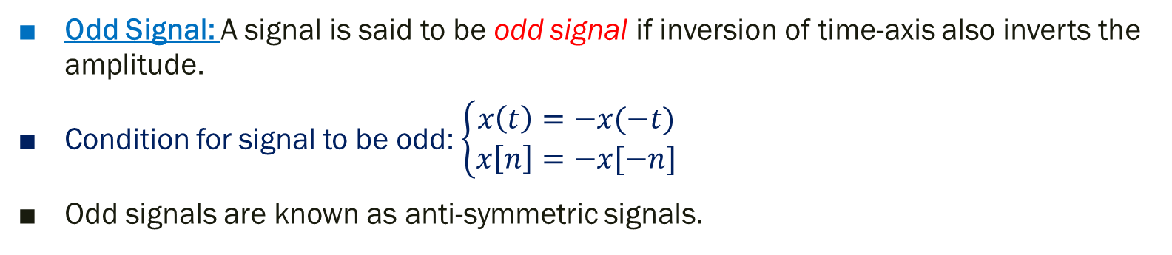
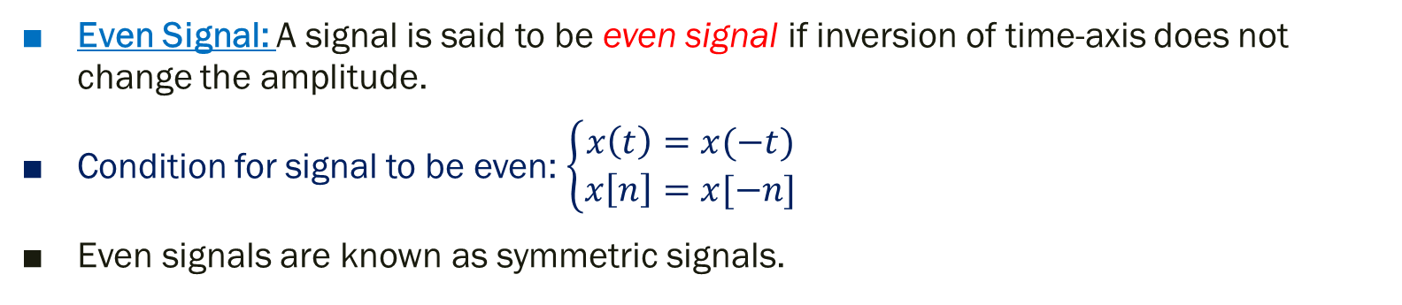
1. Even and Odd Signals
Even Signal: A signal is said to be even signal if inversion of time-axis does not change the amplitude.
Condition for signal to be even: $\left\{\begin{aligned}x\left(t\right)=x(−t) \\ x\left[n\right]=x[−n]\end{aligned}\right.$
Even signals are known as symmetric signals.
Odd Signal: A signal is said to be odd signal if inversion of time-axis also inverts the amplitude.
Condition for signal to be odd: $\left\{\begin{aligned}x\left(t\right)=−x(−t) \\ x\left[n\right]=−x[−n]\end{aligned}\right.$
Odd signals are known as anti-symmetric signals.

Slide 4
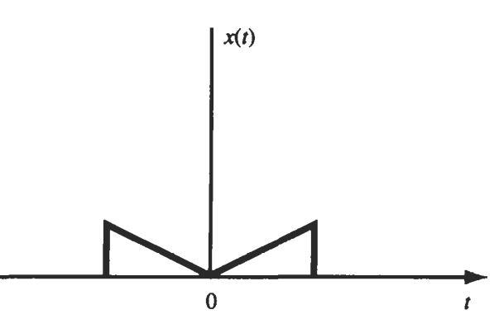
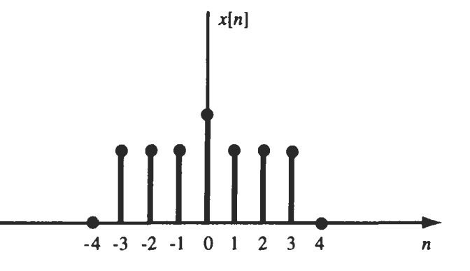
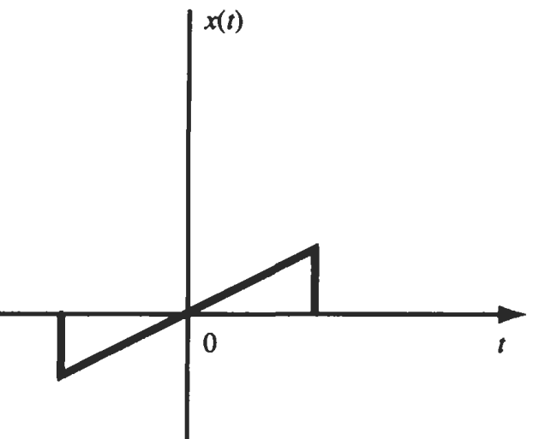
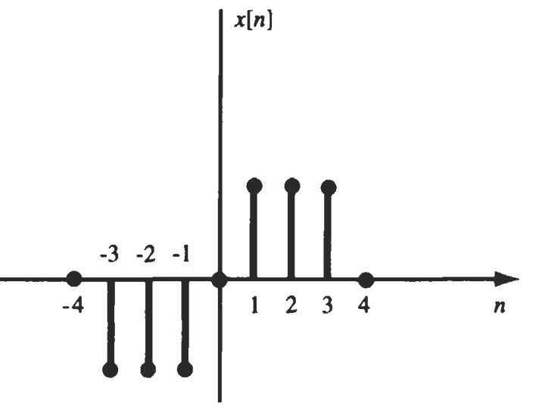
Examples of Even Signals
Examples of Odd Signals

Slide 5
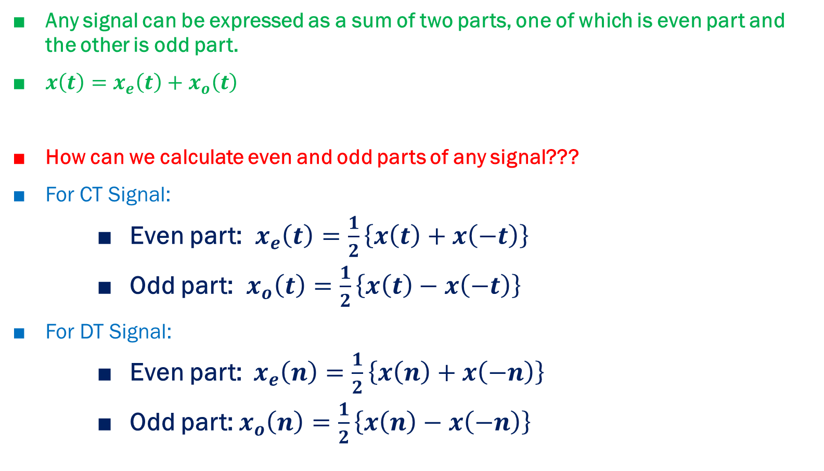
Any signal can be expressed as a sum of two parts, one of which is even part and the other is odd part.
$x\left(t\right)=x_{e}\left(t\right)+x_{o}\left(t\right)$
How can we calculate even and odd parts of any signal???
For CT Signal:
Even part: $x_{e}\left(t\right)=\frac{1}{2}\left\{x\left(t\right)+x\left(−t\right)\right\}$
Odd part: $x_{o}\left(t\right)=\frac{1}{2}\left\{x\left(t\right)−x\left(−t\right)\right\}$
For DT Signal:
Even part: $x_{e}\left(n\right)=\frac{1}{2}\left\{x\left(n\right)+x\left(−n\right)\right\}$
Odd part: $x_{o}\left(n\right)=\frac{1}{2}\left\{x\left(n\right)−x\left(−n\right)\right\}$

Slide 6
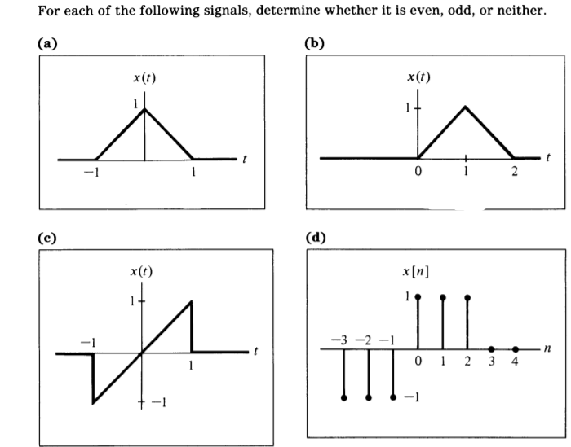
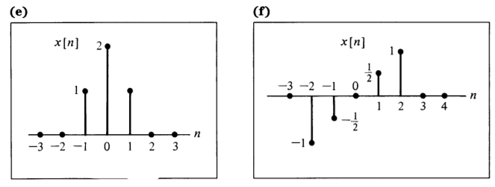
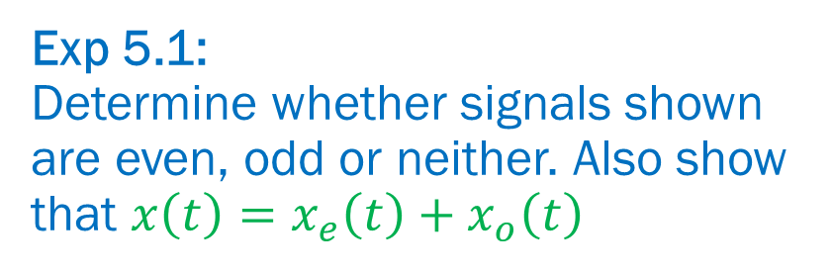
Exp 5.1: Determine whether signals shown are even, odd or neither. Also show that $x\left(t\right)=x_{e}\left(t\right)+x_{o}\left(t\right)$
(a) Even
(b) Neither even nor odd
(c) Odd
(d) Neither even nor odd
(e) Even
(f) Odd

Slide 7
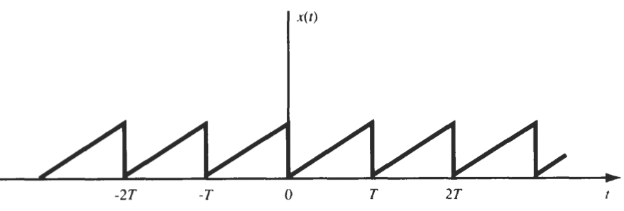
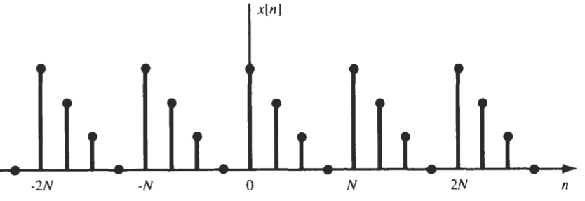
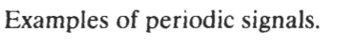
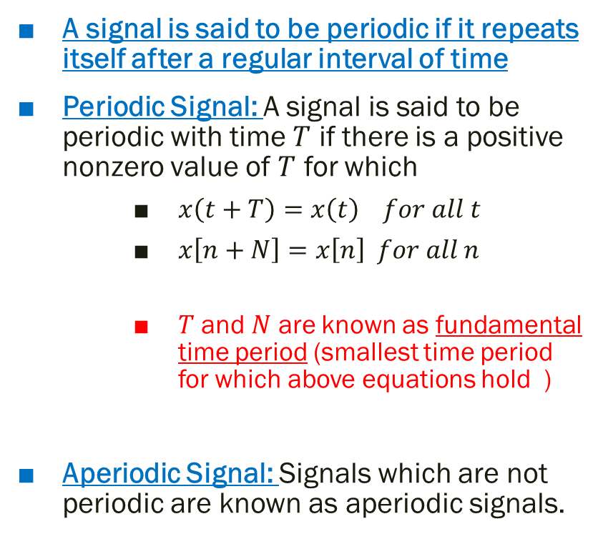
2. Periodic and Aperiodic Signals
A signal is said to be periodic if it repeats itself after a regular interval of time
Periodic Signal: A signal is said to be periodic with time $T$ if there is a positive nonzero value of $T$ for which
$x\left(t+T\right)=x\left(t\right) for all t$
$x\left[n+N\right]=x\left[n\right] for all n$
$T$ and $N$ are known as fundamental time period (smallest time period for which above equations hold )
Aperiodic Signal: Signals which are not periodic are known as aperiodic signals.

Slide 8
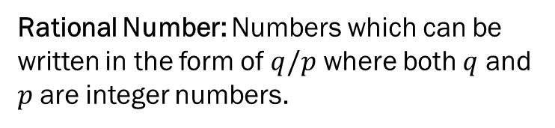
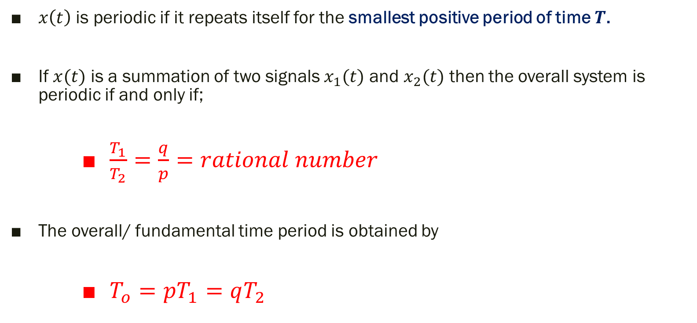
Periodicity for CT signals
$x\left(t\right)$ is periodic if it repeats itself for the smallest positive period of time $T$.
If $x(t)$ is a summation of two signals $x_{1}(t)$ and $x_{2}(t)$ then the overall system is periodic if and only if;
$\frac{T_{1}}{T_{2}}=\frac{q}{p}=rational number$
The overall/ fundamental time period is obtained by
$T_{o}=pT_{1}=qT_{2}$
Rational Number: Numbers which can be written in the form of $q/p$ where both $q$ and $p$ are integer numbers.

Slide 9
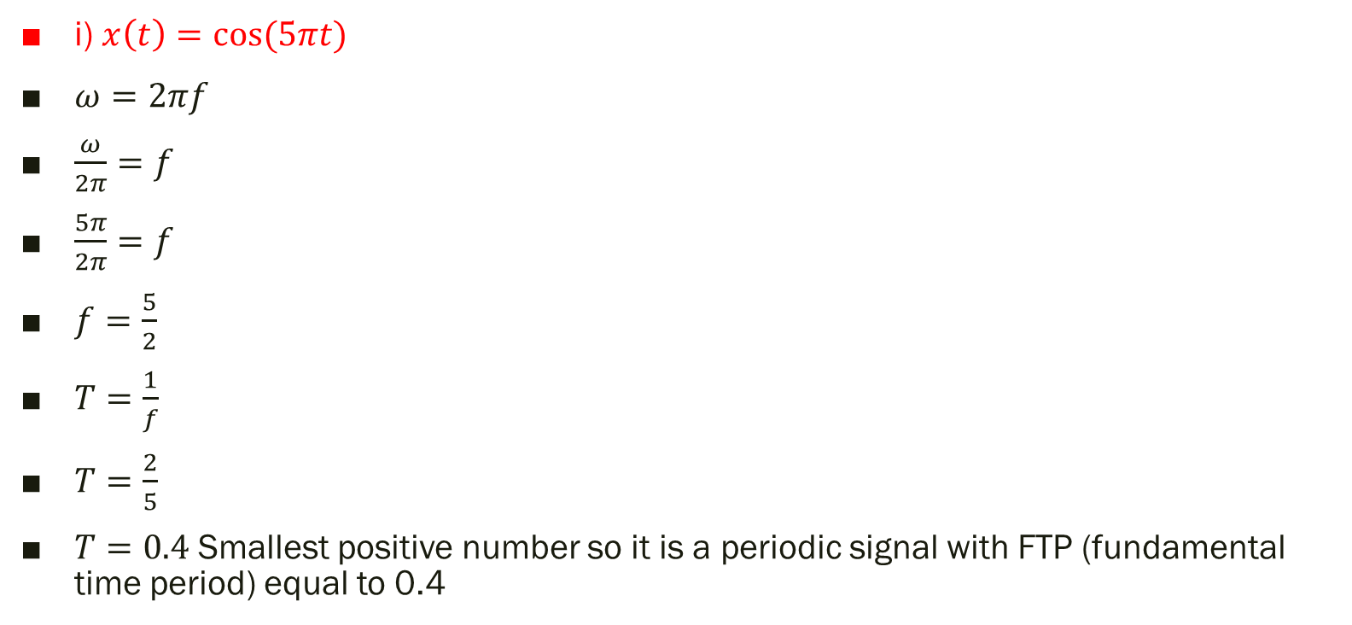
Exp 5.3: Find periodicity
i) $x\left(t\right)=\cos{(5πt)}$
$ω=2πf$
$\frac{ω}{2π}=f$
$\frac{5π}{2π}=f$
$f=\frac{5}{2}$
$T=\frac{1}{f}$
$T=\frac{2}{5}$
$T=0.4$ Smallest positive number so it is a periodic signal with FTP (fundamental time period) equal to 0.4

Slide 10
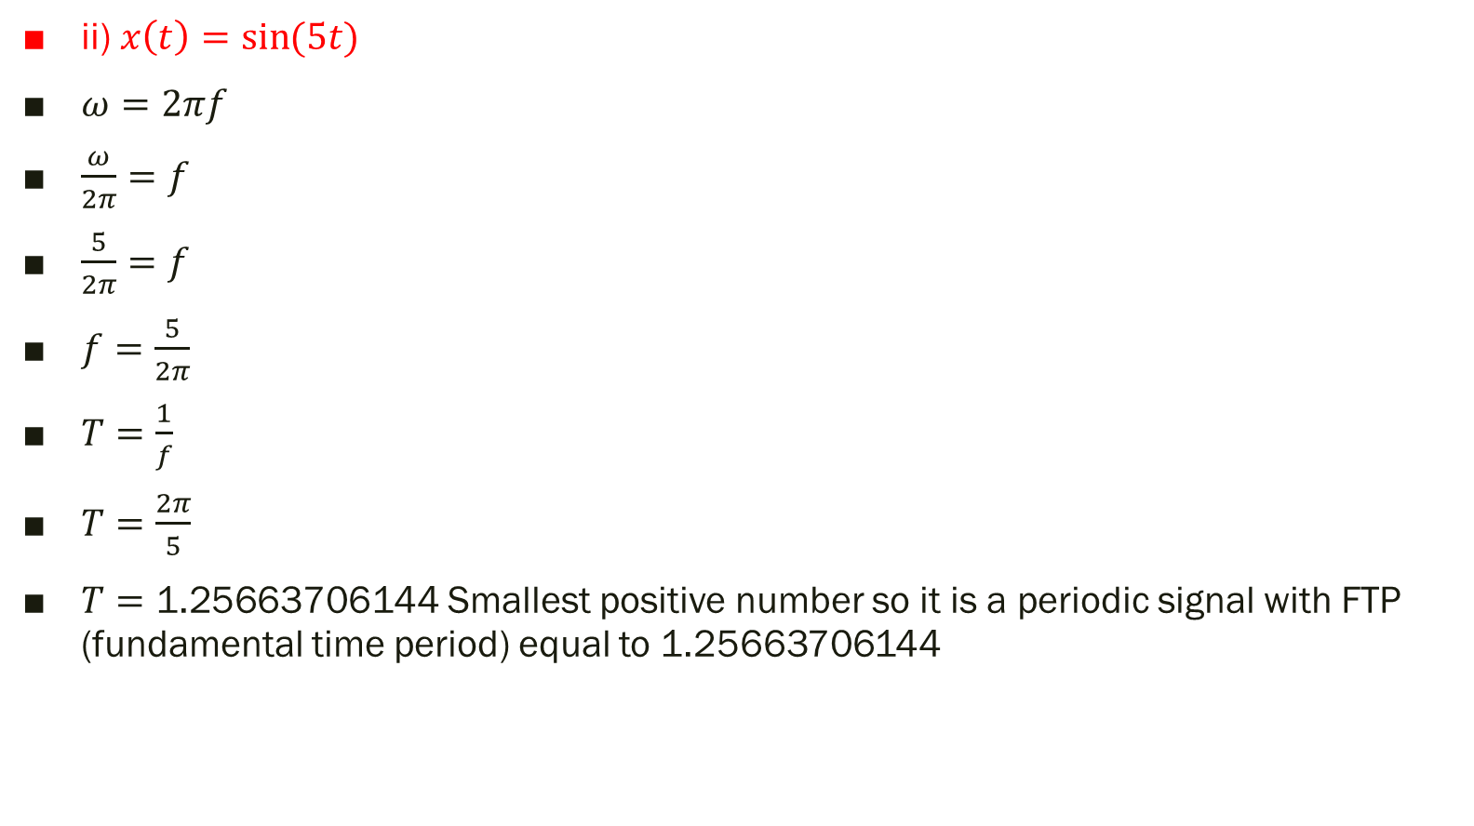
ii) $x\left(t\right)=\sin{(5t)}$
$ω=2πf$
$\frac{ω}{2π}=f$
$\frac{5}{2π}=f$
$f=\frac{5}{2π}$
$T=\frac{1}{f}$
$T=\frac{2π}{5}$
$T=\text{1.25663706144}$ Smallest positive number so it is a periodic signal with FTP (fundamental time period) equal to 1.25663706144

Slide 11
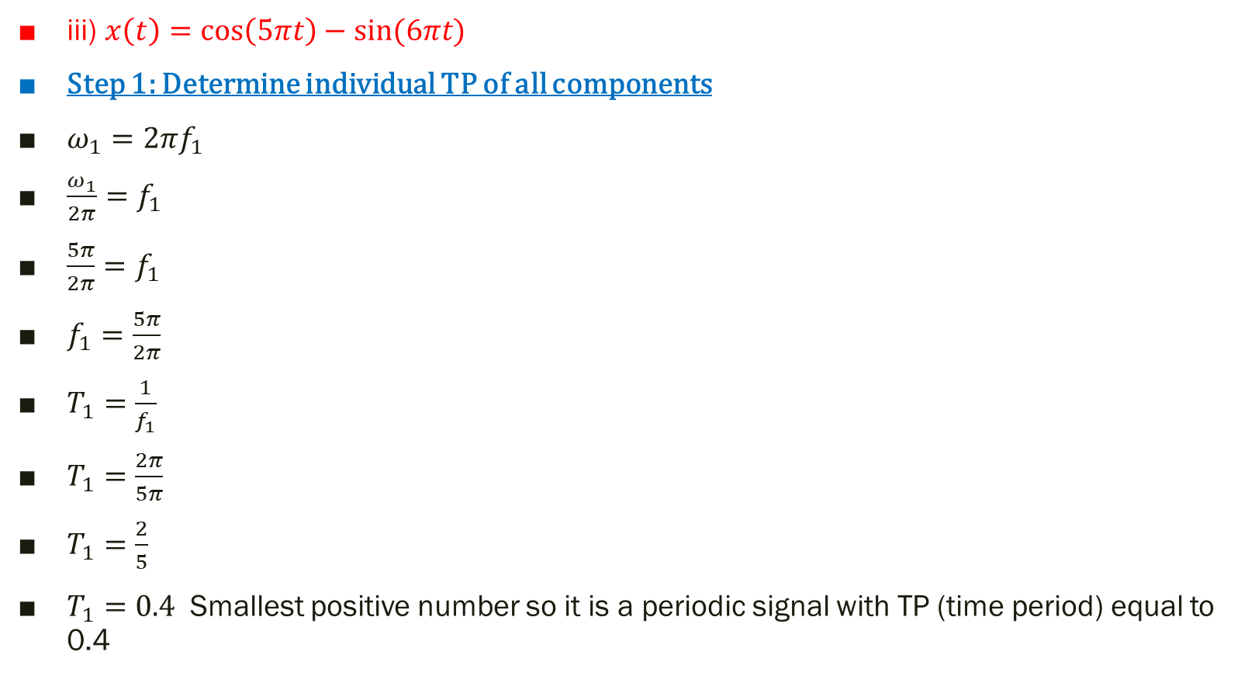
iii) $x\left(t\right)=\cos\left(5πt\right)−\sin{(6πt)}$
Step 1: Determine individual TP of all components
$ω_{1}=2πf_{1}$
$\frac{ω_{1}}{2π}=f_{1}$
$\frac{5π}{2π}=f_{1}$
$f_{1}=\frac{5π}{2π}$
$T_{1}=\frac{1}{f_{1}}$
$T_{1}=\frac{2π}{5π}$
$T_{1}=\frac{2}{5}$
$T_{1}=0.4$ Smallest positive number so it is a periodic signal with TP (time period) equal to 0.4

Slide 12
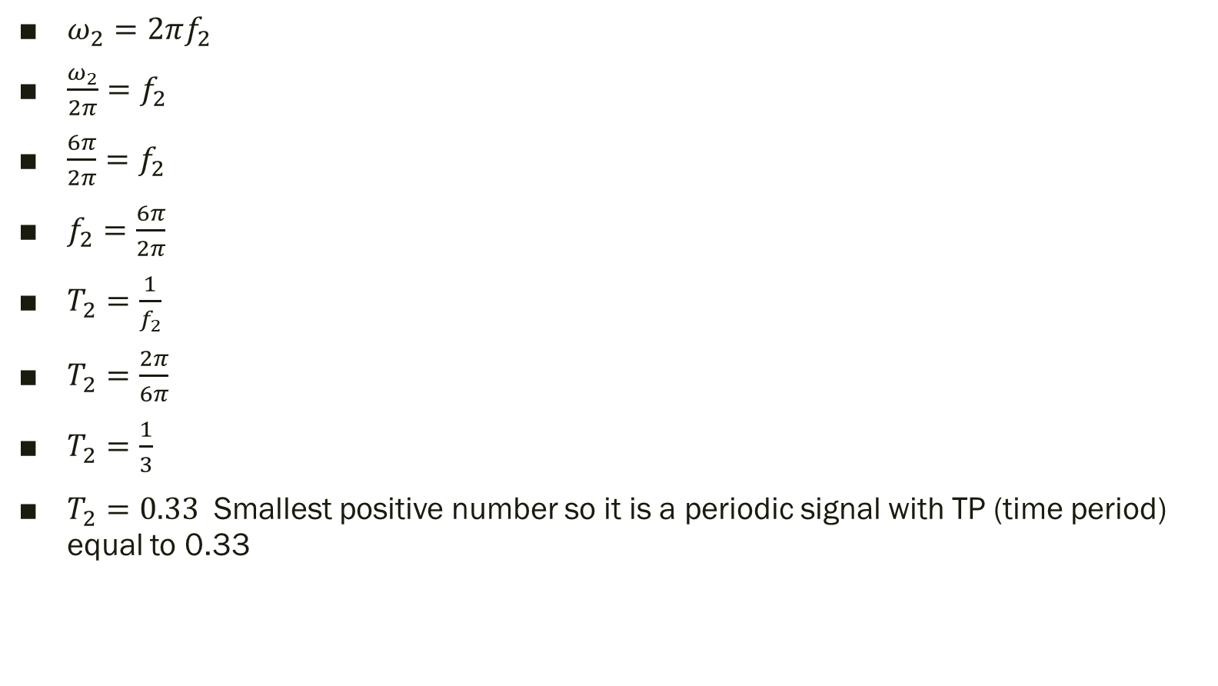
$ω_{2}=2πf_{2}$
$\frac{ω_{2}}{2π}=f_{2}$
$\frac{6π}{2π}=f_{2}$
$f_{2}=\frac{6π}{2π}$
$T_{2}=\frac{1}{f_{2}}$
$T_{2}=\frac{2π}{6π}$
$T_{2}=\frac{1}{3}$
$T_{2}=0.33$ Smallest positive number so it is a periodic signal with TP (time period) equal to 0.33

Slide 13
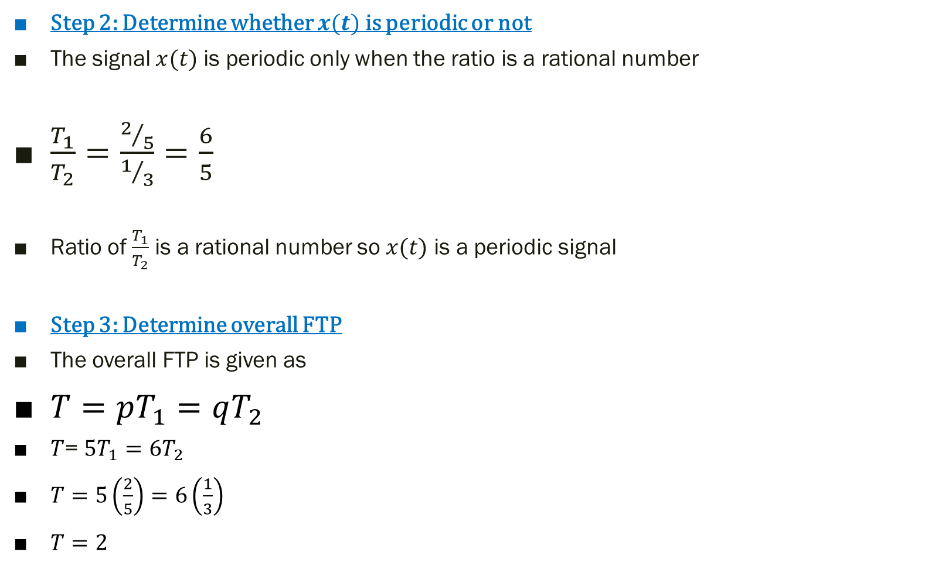
Step 2: Determine whether $x(t)$ is periodic or not
The signal $x(t)$ is periodic only when the ratio is a rational number
$\frac{T_{1}}{T_{2}}=\frac{2/5}{1/3}=\frac{6}{5}$
Ratio of $\frac{T_{1}}{T_{2}}$ is a rational number so $x(t)$ is a periodic signal
Step 3: Determine overall FTP
The overall FTP is given as
$T=pT_{1}=qT_{2}$
$T$= $5T_{1}=6T_{2}$
$T=5\left(\frac{2}{5}\right)=6\left(\frac{1}{3}\right)$
$T=2$

Slide 14
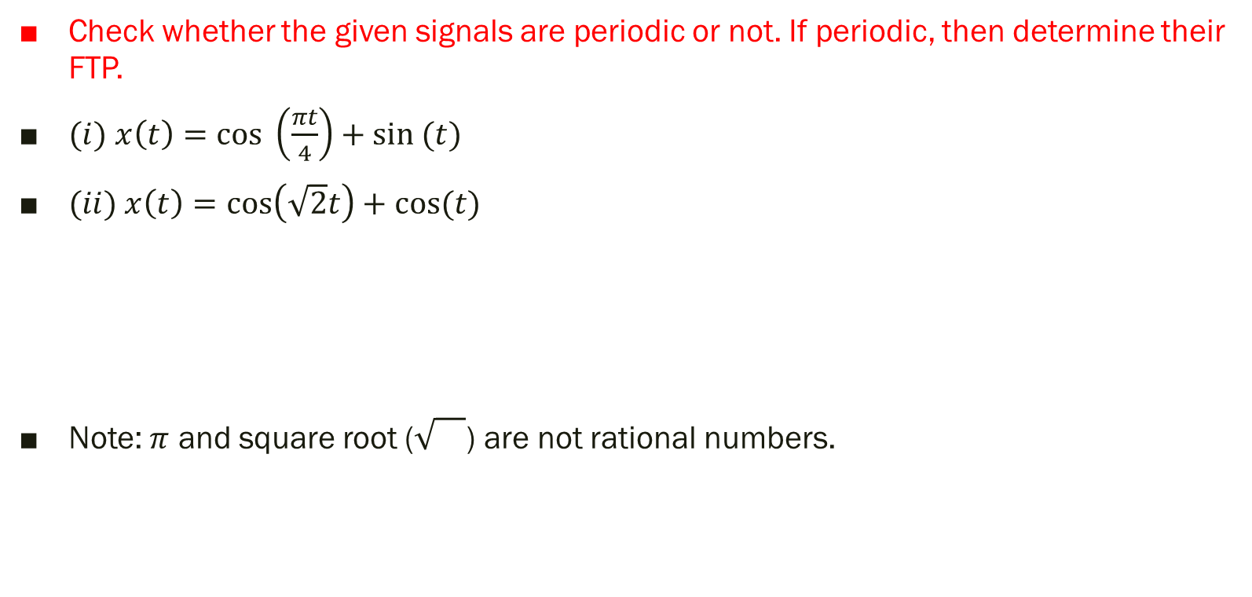
P.P 5.1
Check whether the given signals are periodic or not. If periodic, then determine their FTP.
$(i)$ $x\left(t\right)=$ $cos \left(\frac{πt}{4}\right)+sin (t)$
$(ii) x\left(t\right)=\cos\left(\sqrt{2}t\right)+\cos{(t)}$
Note: $π$ and square root () are not rational numbers.

Slide 15
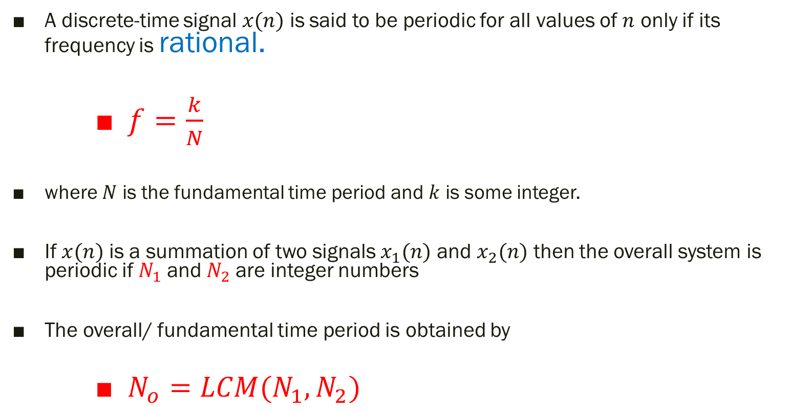
Periodicity for DT signals
A discrete-time signal $x(n)$ is said to be periodic for all values of $n$ only if its frequency is rational.
$f=\frac{k}{N}$
where $N$ is the fundamental time period and $k$ is some integer.
If $x(n)$ is a summation of two signals $x_{1}(n)$ and $x_{2}(n)$ then the overall system is periodic if $N_{1}$ and $N_{2}$ are integer numbers
The overall/ fundamental time period is obtained by
$N_{o}=$ $LCM(N_{1},N_{2})$

Slide 16
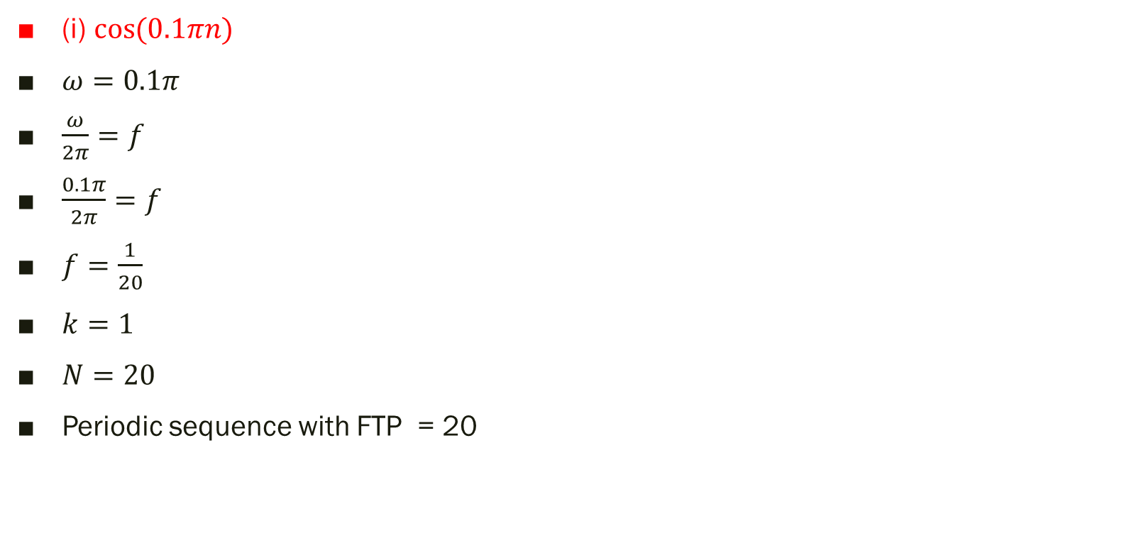
Exp 5.4: Find periodicity
(i) $\cos{(0.1πn)}$
$ω=0.1π$
$\frac{ω}{2π}=f$
$\frac{0.1π}{2π}=f$
$f=\frac{1}{20}$
$k=1$
$N=20$
Periodic sequence with FTP = 20

Slide 17
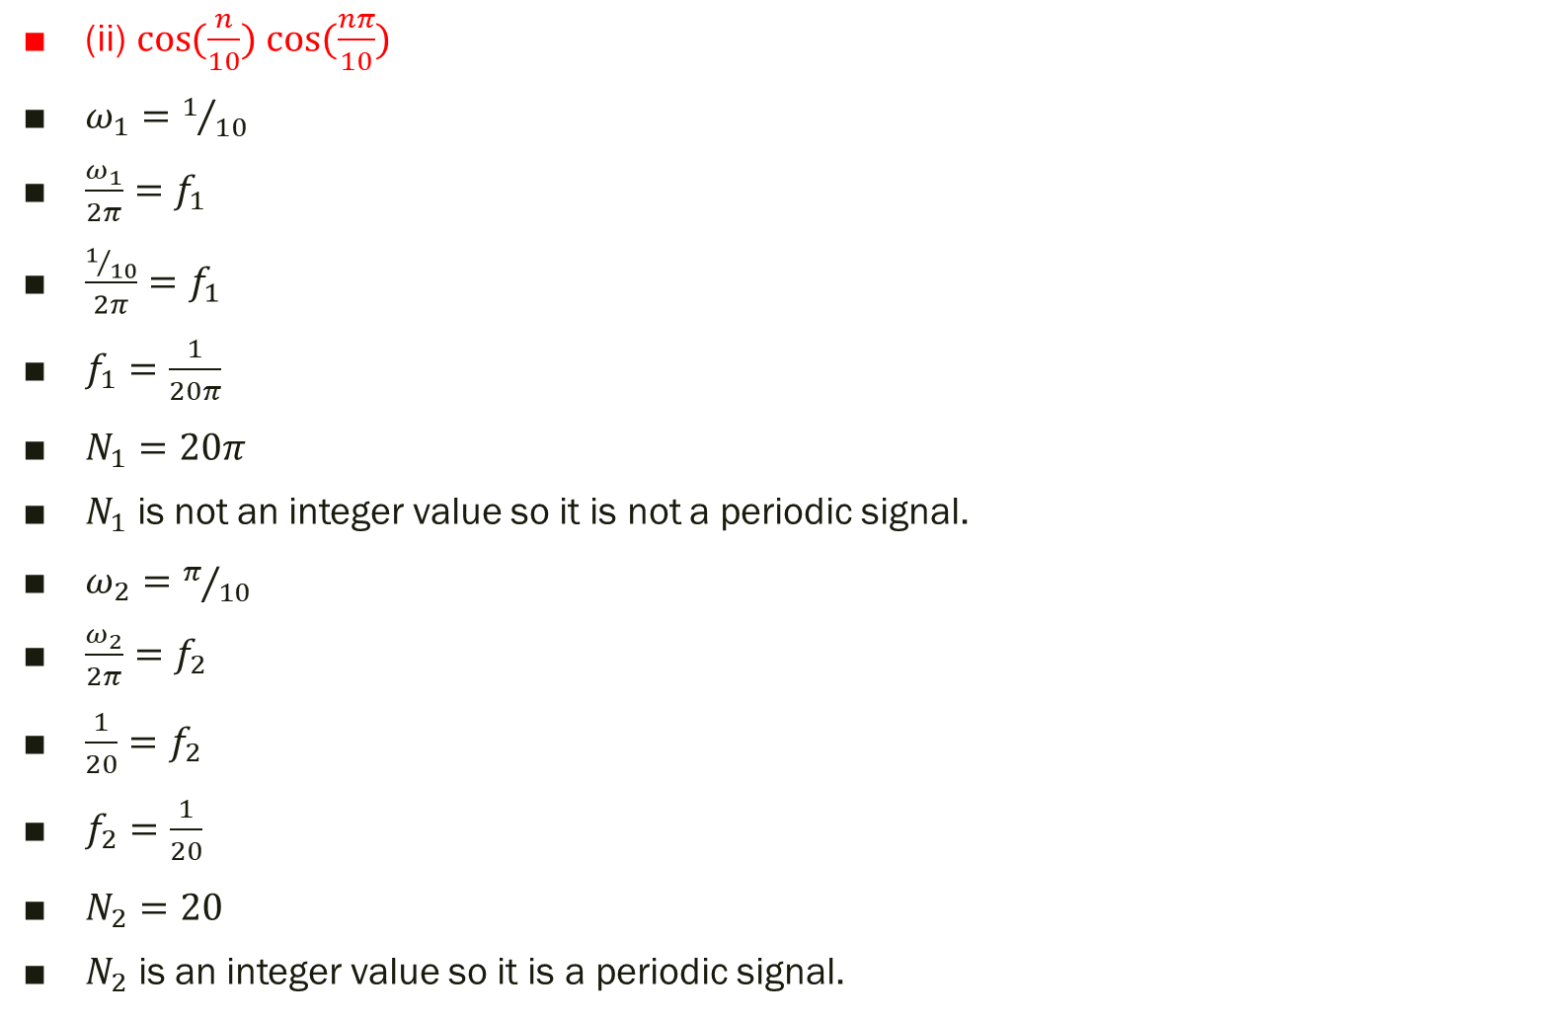
(ii) $\cos{(\frac{n}{10})}$ $\cos{(\frac{nπ}{10})}$
$ω_{1}=1/{10}$
$\frac{ω_{1}}{2π}=f_{1}$
$\frac{1/{10}}{2π}=f_{1}$
$f_{1}=\frac{1}{20π}$
$N_{1}=20π$
$N_{1}$ is not an integer value so it is not a periodic signal.
$ω_{2}=π/{10}$
$\frac{ω_{2}}{2π}=f_{2}$
$\frac{1}{20}=f_{2}$
$f_{2}=\frac{1}{20}$
$N_{2}=20$
$N_{2}$ is an integer value so it is a periodic signal.
Therefore, the given signal is non=periodic

Slide 18
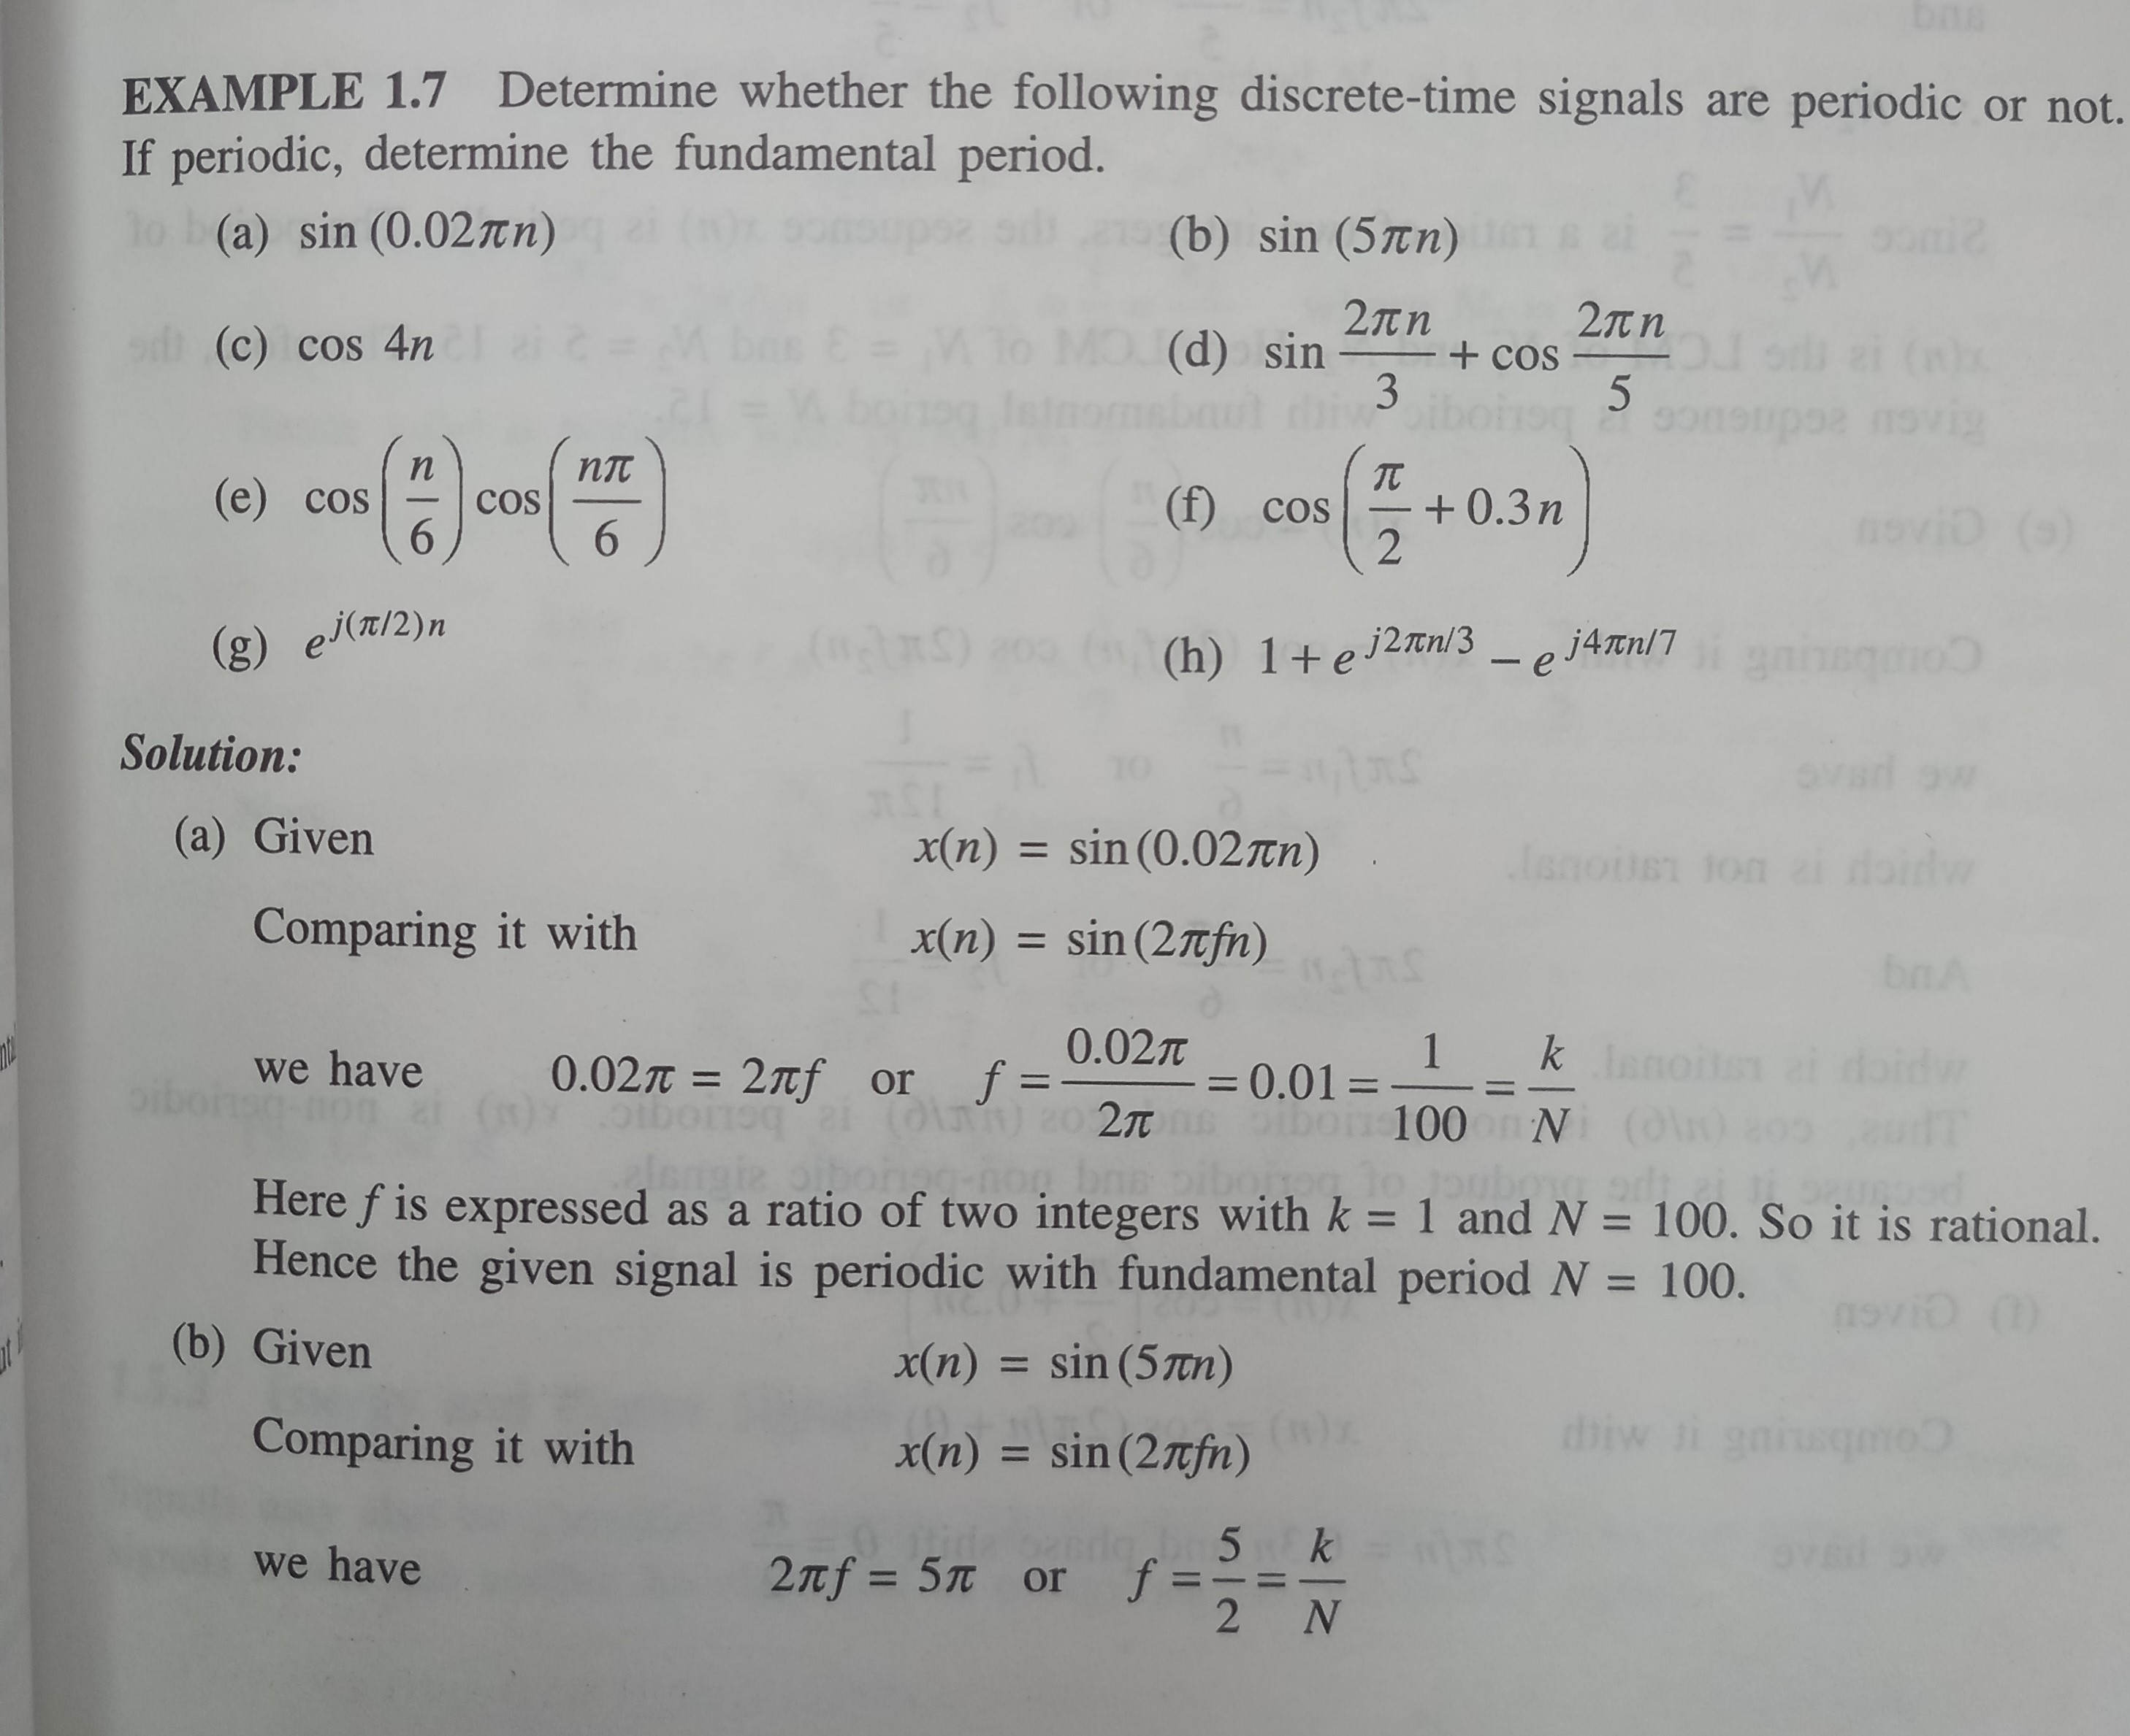

Slide 19
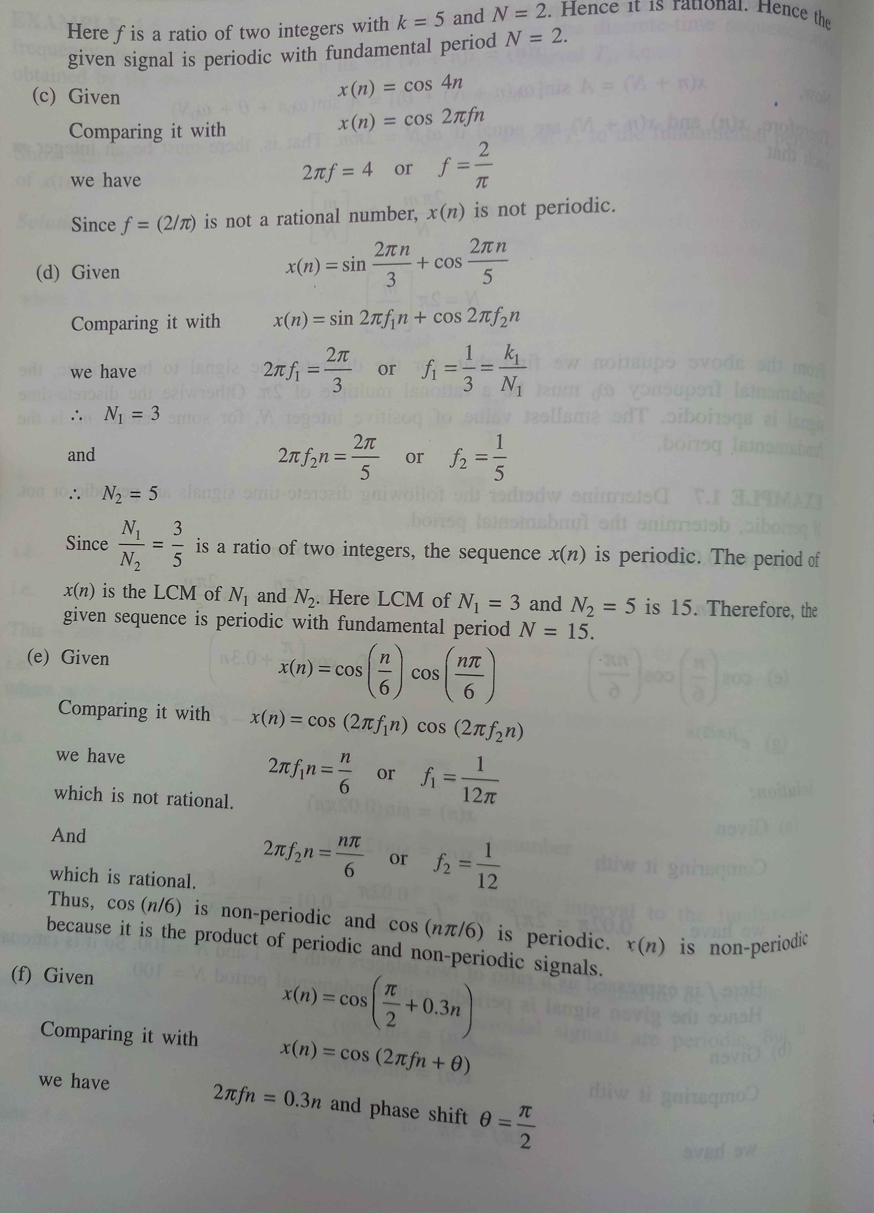

Slide 20
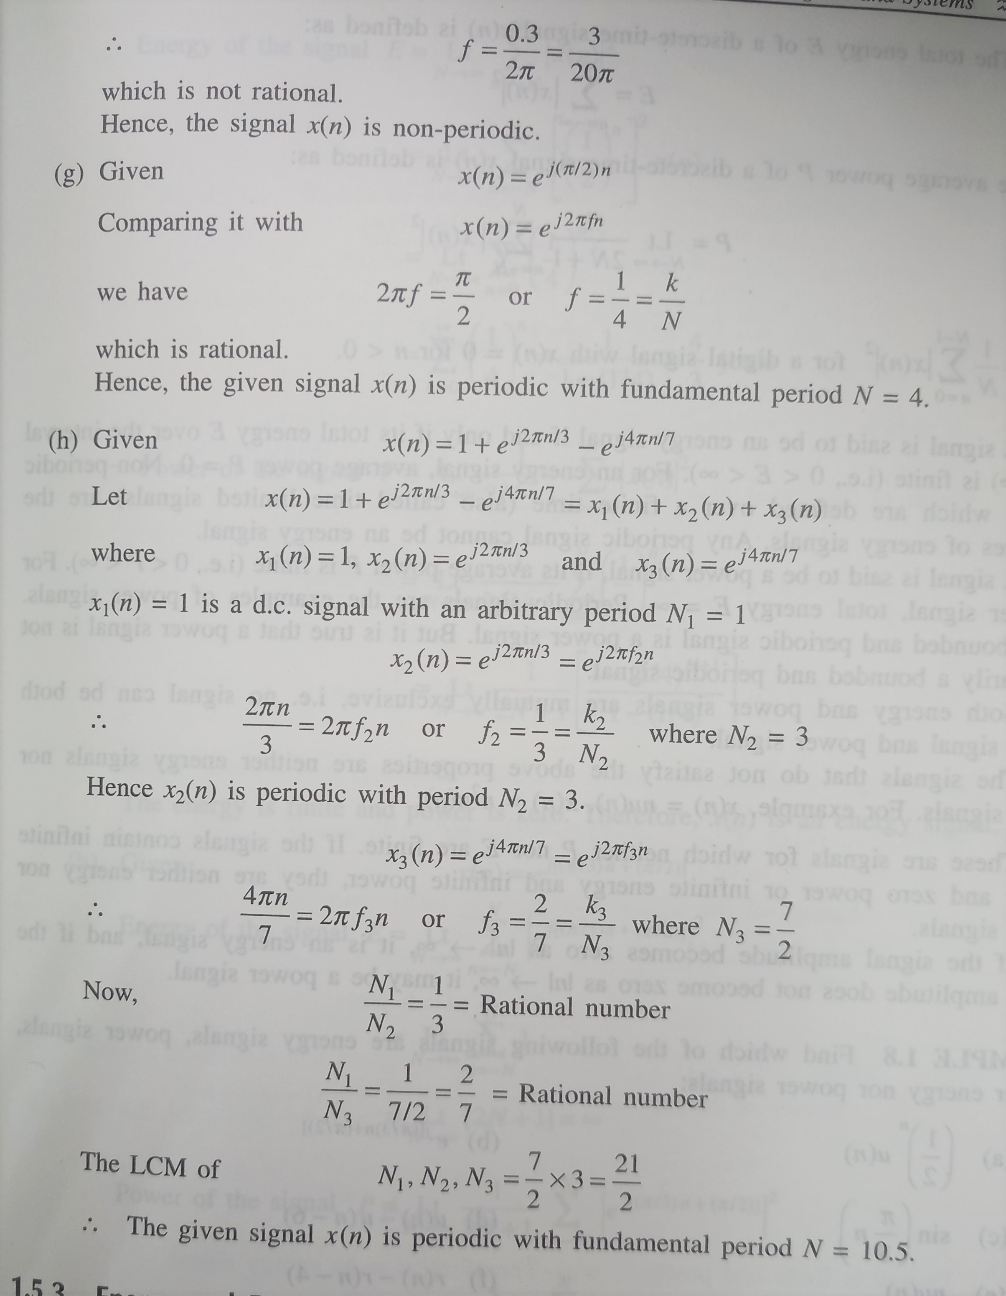

Slide 21
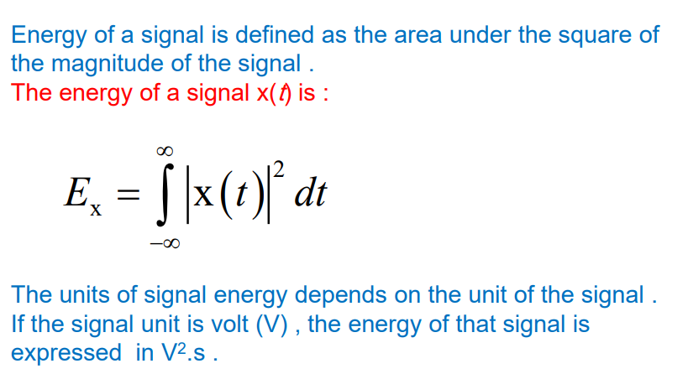
3. Energy and Power Signals

Slide 22
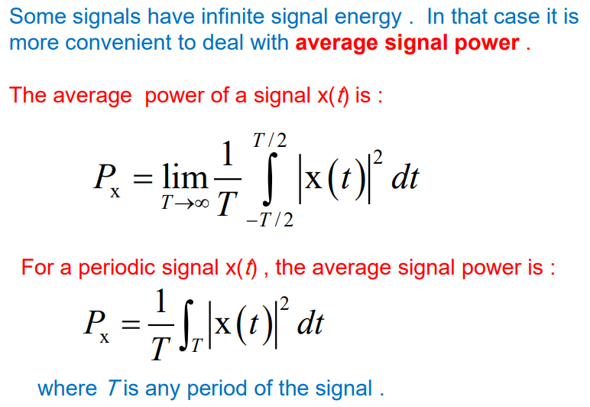

Slide 23
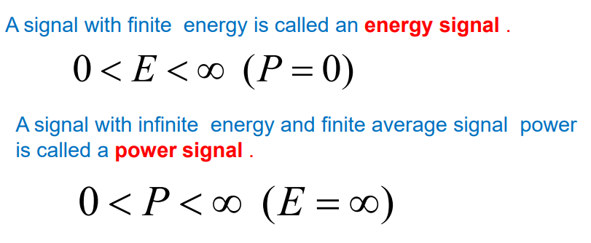

Slide 24
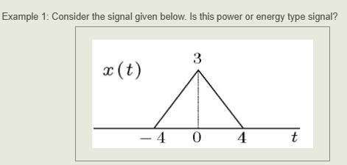

Slide 25
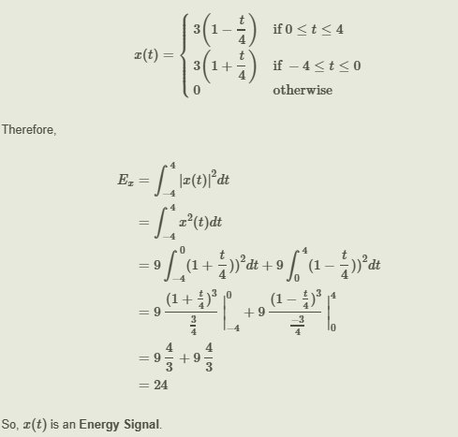

Slide 26
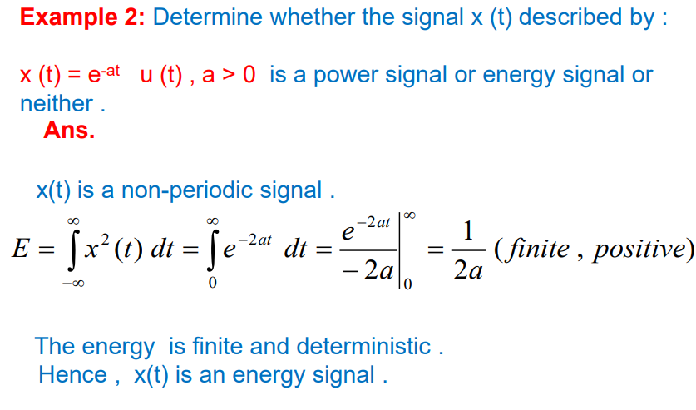

Slide 27
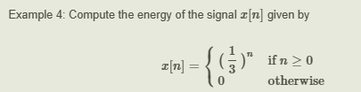
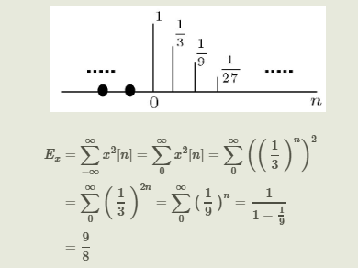

Slide 28
Thank You !!!

